Slide 1

Penetration Testing: MonitorsThree and Relevant Machines
This graduation project showcases advanced penetration testing techniques on MonitorsThree and Relevant machines. Our team demonstrates expertise in identifying vulnerabilities, exploiting weaknesses, and gaining root access to target systems.
Our Team
Hazem Mohamed Mohy Eldeen
Abdelrahman Ahmed Mohamed
Yara Mohamed Mohy Eldeen
Ethar Hassan Mohamed

Slide 2

Project Introduction
1
Project Overview
Comprehensive analysis of MonitorsThree and Relevant machines, focusing on web applications and network infrastructure.
2
Testing Goal
Conduct thorough penetration tests to identify vulnerabilities and achieve root access on target systems.
3
Project Timeline
Three-month engagement, including planning, execution, analysis, and reporting phases for both target systems.

Slide 3
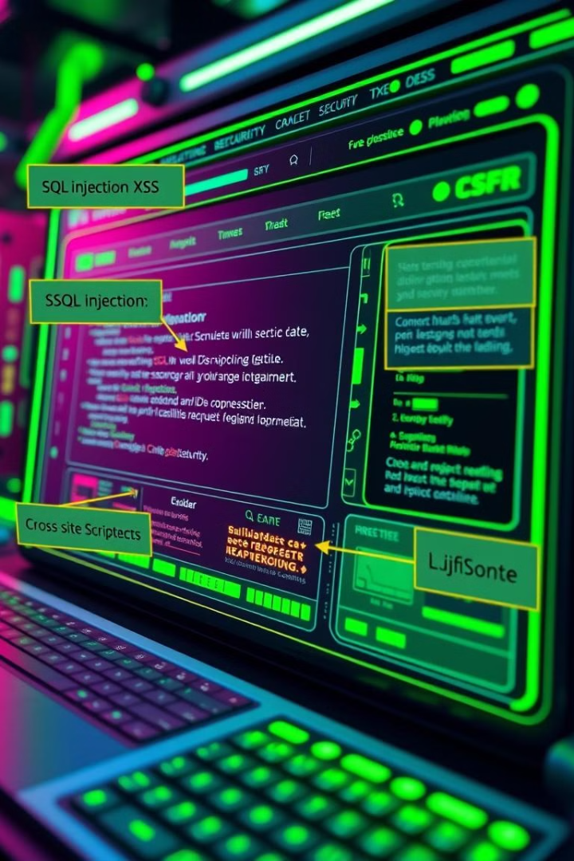
MonitorsThree Executive Summary
Target
Objective
MonitorsThree web application, a complex monitoring system provided by HackTheBox for penetration testing.
Identify and exploit vulnerabilities to gain root access, demonstrating potential real-world attack scenarios.
Outcome
Successfully uncovered high-severity vulnerabilities, including SQL injection and remote code execution flaws.

Slide 4

MonitorsThree Key Findings
1
SQL Injection Vulnerability
2
Outdated Cacti Version
3
Duplicati Bypass
Password reset page susceptible to SQL injection, exposing user credentials and database structure.
Exploitation of CVE-2024-25641 in Cacti allowed remote code execution and system compromise.
JavaScript console injection technique bypassed Duplicati's authentication, granting unauthorized access to backups.

Slide 5




Methodology - MonitorsThree
Enumeration
Used Nmap and Nikto for comprehensive port scanning and web application vulnerability assessment.
Exploitation
Leveraged Sqlmap for automated SQL injection and Metasploit for CVE exploitation.
Privilege Escalation
Employed custom scripts and ffuf for fuzzing to identify and exploit privilege escalation vectors.

Slide 6
Business Impact for MonitorsThree
Confidentiality
Integrity
Availability
Exposed sensitive user data and database credentials, potentially leading to identity theft and fraud.
SQL injection vulnerability allows unauthorized data manipulation, compromising the accuracy of stored information.
Remote code execution risk could lead to system downtime, affecting business operations and customer trust.

Slide 7




Recommendations for MonitorsThree
Patch Outdated Software
SQL Injection Prevention
Enhance Authentication
Immediately update Cacti to the latest version to mitigate CVE-2024-25641 and similar vulnerabilities.
Implement prepared statements and input validation to secure the password reset functionality.
Deploy multi-factor authentication and implement strict password policies across all systems.

Slide 8
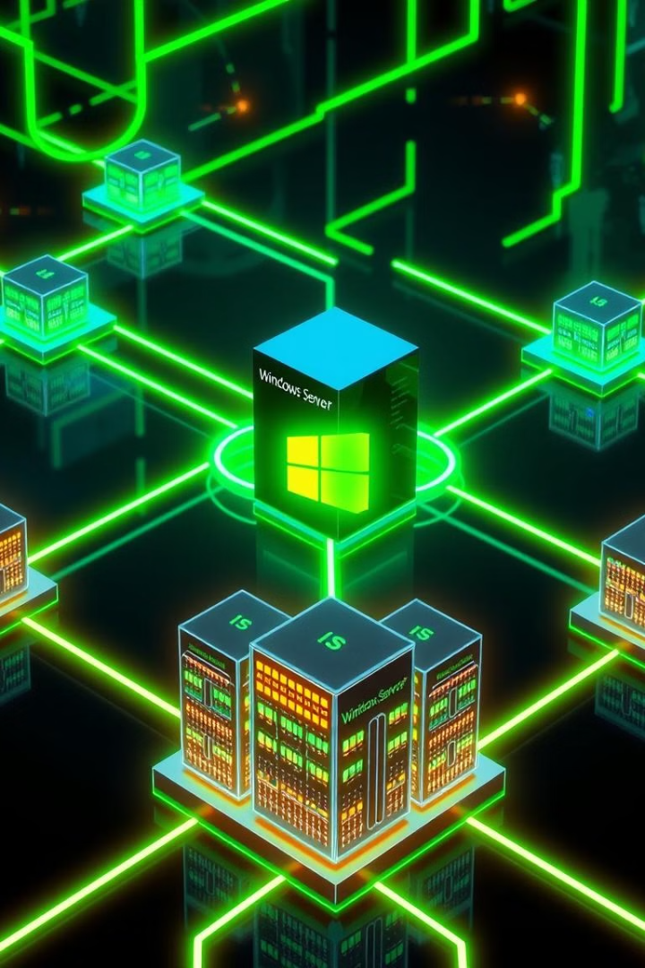
Relevant Machine Executive Summary
Target
Relevant network infrastructure (Windows Server 2016, IIS)
Objective
Assess vulnerabilities and identify sensitive data access risks
Outcome
Full administrative control obtained through multiple attack vectors

Slide 9

Relevant Machine Key Findings
1
EternalBlue Vulnerability (MS17-010)
2
Unsecured SMB Share
Discovered passwords.txt file on an open share, leading to further system compromise.
Exploited to gain initial access, demonstrating the critical nature of unpatched systems.
3
Privilege Escalation via SeImpersonatePrivilege
Utilized PrintSpoofer to exploit Windows privilege escalation, gaining SYSTEM-level access.

Slide 10

Methodology - Relevant Machine
1
Enumeration
Conducted comprehensive port scanning with Nmap, identifying open services and potential vulnerabilities.
2
Exploitation
Leveraged EternalBlue exploit via Metasploit, gaining initial foothold on the target system.
3
Privilege Escalation
Exploited SeImpersonatePrivilege using PrintSpoofer, achieving full SYSTEM-level access on the machine.

Slide 11
Business Impact for MonitorsThree
Confidentiality
Integrity
Availability
Unauthorized access to sensitive data in unsecured SMB shares.
Potential for privileged users to modify or delete critical data.
Exploitable SMB vulnerability could lead to system downtime and data loss.

Slide 12
Recommendations for RELEVANT
Patch SMBv1
Secure SMB Shares
Harden RDP
Eliminate EternalBlue vulnerability with the latest security updates.
Restrict access to sensitive directories.
Implement network-level authentication and restrict RDP access to trusted IPs.

